Slide 1
Chapter four
Software Quality Attributes

Slide 2
Topics
Quality Attributes
Understanding Quality Attributes
Achieving Qualities (Tactics)

Slide 3
Architecture and quality attributes
Achieving quality attributes must be considered throughout design, implementation, and deployment. No quality attribute is entirely dependent on design, nor is it entirely dependent on implementation or deployment. For example:
Usability involves both architectural and non-architectural aspects
Modifiability is determined by how functionality is divided (architectural) and by coding techniques within a module (non-architectural).
Performance involves both architectural and non-architectural dependencies
Architecture is critical to the realization of many qualities of interest in a system, and these qualities should be designed in and can be evaluated at the architectural level
Architecture, by itself, is unable to achieve qualities. It provides the foundation for achieving quality.

Slide 4
System Quality Attributes
Much of a software architect’s life is spent designing software systems to meet a set of quality attribute requirements.
General software quality attributes include scalability, security, performance and reliability.
These are often informally called an application’s “-ilities” (though of course many, like performance, don’t quite fit this lexical specification).
Quality attribute requirements are part of an application’s nonfunctional requirements, which capture the many facets of how the functional requirements of an application are achieved.

Slide 5
QUALITY ATTRIBUTE SCENARIOS
A quality attribute scenario is a quality-attribute-specific requirement.
It consists of six parts
Source of stimulus. This is some entity (a human, a computer system, or any other actuator) that generated the stimulus.
Stimulus. The stimulus is a condition that requires a response when it arrives at a system.
Environment. The stimulus occurs within certain conditions. The system may be in an overload condition or may be running when the stimulus occurs, or some other condition may be true.
Artifact. Some artifact is stimulated. This may be the whole system or some pieces of it.
Response. The response is the activity undertaken after the arrival of the stimulus.
Response measure. When the response occurs, it should be measurable in some fashion so that the requirement can be tested.

Slide 6
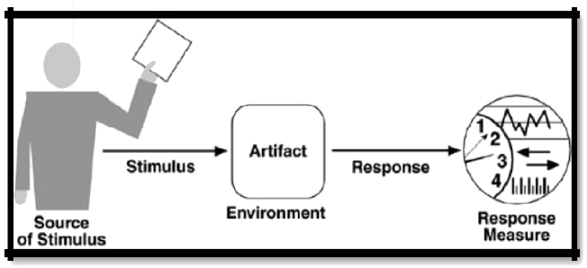
Figure 4.1 shows the parts of a quality attribute scenario

Slide 7
PERFORMANCE SCENARIO:
Performance is about timing.
Events (interrupts, messages, requests from users, or the passage of time) occur, and the system must respond to them.
There are a variety of characterizations of event arrival and response but basically performance is concerned with how long it takes the system to respond when an event occurs.
Stimulus. The stimuli are the event arrivals. The arrival pattern can be characterized as periodic, stochastic/random, or sporadic/irregular. In our example, the stimulus is the stochastic initiation of 1,000 transactions per minute.
Artifact. The artifact is always the system's services, as it is in our example.

Slide 8
Conti…
Environment. The system can be in various operational modes, such as normal, emergency, or overload. In our example, the system is in normal mode.
Response. The system must process the arriving events. This may cause a change in the system environment (e.g., from normal to overload mode). In our example, the transactions are processed.
Response measure. The response measures are the time it takes to process the arriving events (latency or a deadline by which the event must be processed), the variation in this time (jitter), the number of events that can be processed within a particular time interval (throughput), or a characterization of the events that cannot be processed (miss rate, data loss). In our example, the transactions should be processed with an average latency of two seconds.

Slide 9
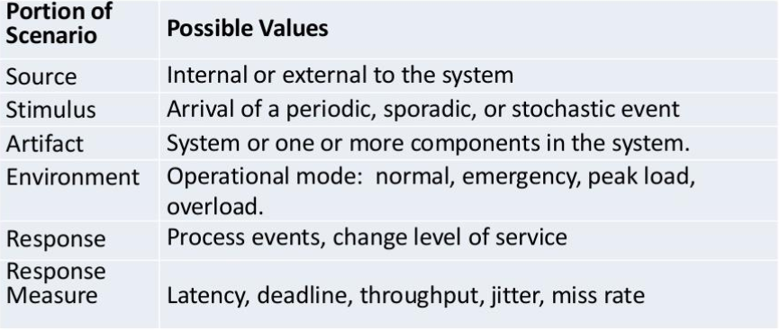
Conti…

Slide 10
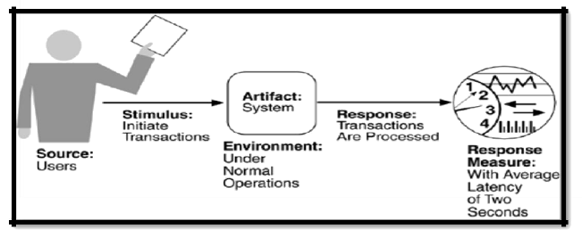
Figure 4.2 Shows The Parts of Performance Scenario

Slide 11
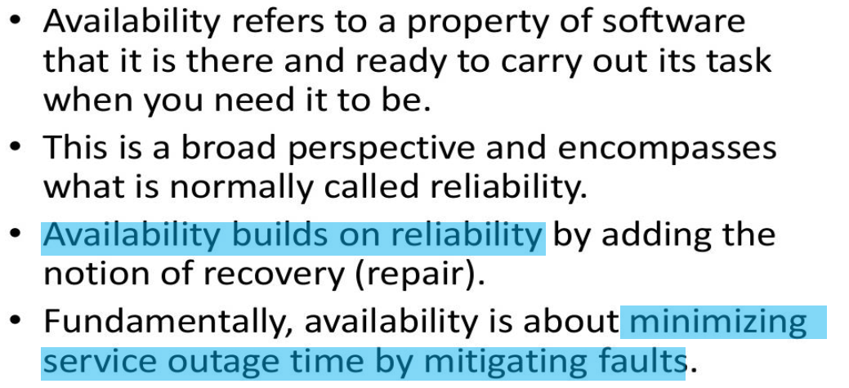
Availability

Slide 12
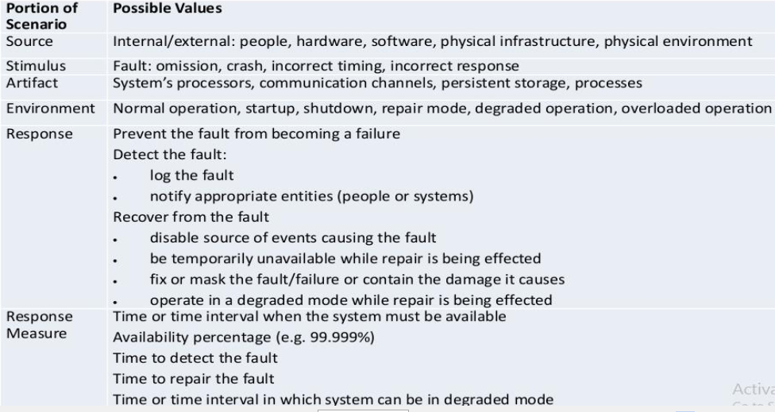
Availability General Scenario

Slide 13
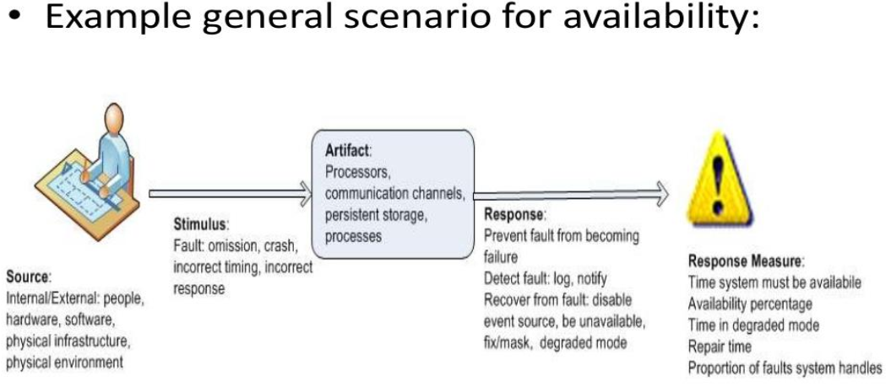
Conti…

Slide 14
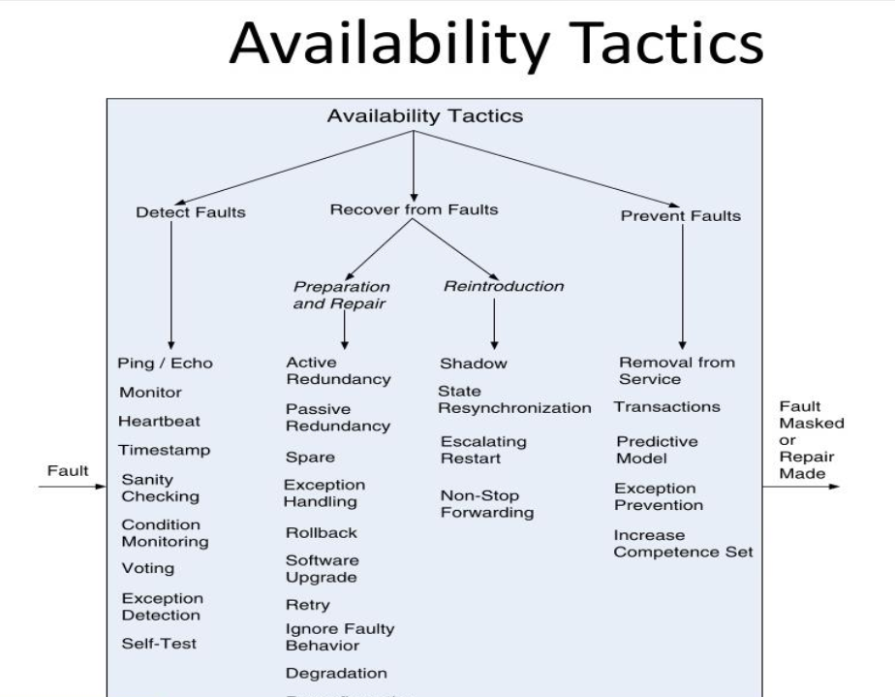

Slide 15
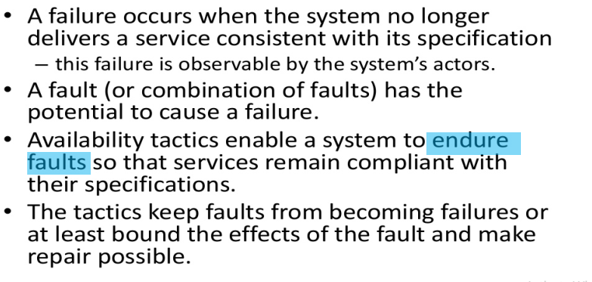
Goals of Availability Tactics

Slide 16
SECURITY SCENARIO
Security is a measure of the system's ability to resist unauthorized usage while still providing its services to legitimate users. An attempt to breach security is called an attack and can take a number of forms. It may be an unauthorized attempt to access data or services or to modify data, or it may be intended to deny services to legitimate users.
Security can be characterized as a system providing non-repudiation, confidentiality, integrity, assurance, availability, and auditing. For each term, we provide a definition and an example.

Slide 17
Conti…
Non-repudiation is the property that a transaction (access to or modification of data or services) cannot be denied by any of the parties to it. This means you cannot deny that you ordered that item over the Internet if, in fact, you did.
Confidentiality is the property that data or services are protected from unauthorized access. This means that a hacker cannot access your income tax returns on a government computer.
Integrity is the property that data or services are being delivered as intended. This means that your grade has not been changed since your instructor assigned it.

Slide 18
Conti…
Assurance is the property that the parties to a transaction are whom they purport to be. This means that, when a customer sends a credit card number to an Internet merchant, the merchant is whom the customer thinks they are.
Auditing is the property that the system tracks activities within it at levels sufficient to reconstruct them. This means that, if you transfer money out of one account to another account, in Switzerland, the system will maintain a record of that transfer.
Each of these security categories gives rise to a collection of general scenarios

Slide 19
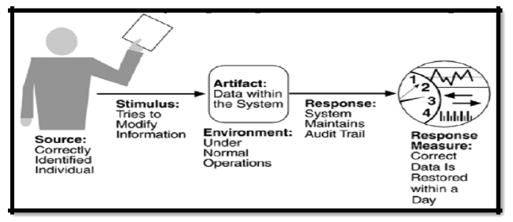
Figure 4.6 Shows The Parts of Security Scenario

Slide 20
Conti…
Source of stimulus. The source of the attack may be either a human or another system. It may have been previously identified (either correctly or incorrectly) or may be currently unknown.
Stimulus. The stimulus is an attack or an attempt to break security. We characterize this as an unauthorized person or system trying to display information, change and/or delete information, access services of the system, or reduce the availability of system services. In Figure, the stimulus is an attempt to modify data.
Artifact. The target of the attack can be either the services of the system or the data within it. In our example, the target is data within the system.
Environment. The attack can come when the system is either online or offline, either connected to or disconnected from a network, either behind a firewall or open to the network.

Slide 21
Conti…
Response. Using services without authorization or preventing legitimate users from using services is a different goal from seeing sensitive data or modifying it. Thus, the system must authorize legitimate users and grant them access to data and services, at the same time rejecting unauthorized users, denying them access, and reporting unauthorized access
Response measure. Measures of a system's response include the difficulty of mounting various attacks and the difficulty of recovering from and surviving attacks. In our example, the audit trail allows the accounts from which money was embezzled to be restored to their original state.

Slide 22
BUSINESS QUALITIES
Time to market
If there is competitive pressure or a short window of opportunity for a system or product, development time becomes important. This in turn leads to pressure to buy or otherwise re-use existing elements.
Cost and benefit
The development effort will naturally have a budget that must not be exceeded. Different architectures will yield different development costs. For instance, an architecture that relies on technology (or expertise with a technology) not resident in the developing organization will be more expensive to realize than one that takes advantage of assets already in-house.
An architecture that is highly flexible will typically be more costly to build than one that is rigid (although it will be less costly to maintain and modify).

Slide 23
Conti…
Projected lifetime of the system
If the system is intended to have a long lifetime, modifiability, scalability, and portability become important. On the other hand, a modifiable, extensible product is more likely to survive longer in the marketplace, extending its lifetime.
Targeted market
For general-purpose (mass-market) software, the platforms on which a system runs as well as its feature set will determine the size of the potential market. Thus, portability and functionality are key to market share. Other qualities, such as performance, reliability, and usability also play a role.

Slide 24
Cont.…
Rollout schedule
If a product is to be introduced as base functionality with many features released later, the flexibility and customizability of the architecture are important. Particularly, the system must be constructed with ease of expansion and contraction in mind.
Integration with legacy systems
If the new system has to integrate with existing systems, care must be taken to define appropriate integration mechanisms. This property is clearly of marketing importance but has substantial architectural implications.

Slide 25
ARCHITECTURE QUALITIES
Conceptual integrity is the underlying theme or vision that unifies the design of the system at all levels. Architecture should do similar things in similar ways.
Correctness and completeness are essential for the architecture to allow for all of the system's requirements and runtime resource constraints to be met.

Slide 26
Summary
Architects must expend a lot of effort in precisely understanding quality attributes so that a design can be conceived to address them.
That’s why an architect must be associated with the requirements gathering exercise for the system,
Understanding the quality attribute requirements is merely a necessary prerequisite to designing a solution to satisfy them.
Creating solutions that choose a point in the design space that adequately satisfies these requirements is remarkably difficult, both technically and socially.
The latter involves communications with stakeholders to discuss design tolerances, discovering scenarios when certain quality requirements can be safely relaxed, and clearly communicating design

Slide 27

Thank You!

